Slide 1
BIT 353 ARTIFICIAL INTELLIGENCE
Lecturer: Saroj Poudel
Qualification: MS CIS&IT
Profession: Senior Software Developer/CTO
Lincoln University College, CN 1221

Slide 2


Machine Learning
In this chapter we will learn about:
Introduction to Machine learning
Forms and learning
Supervised Learning
Linear Regression and Classification
Developing Machine Learning System
Example Problem

Slide 3
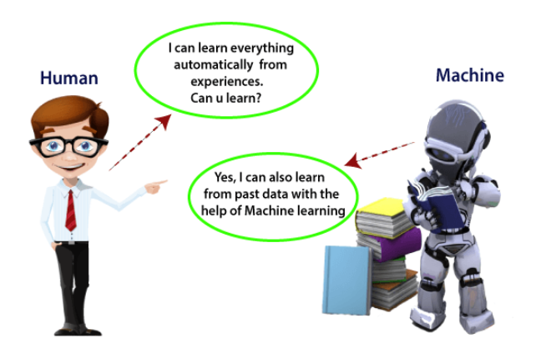
Machine Learning

Slide 4
What is Machine Learning?
The subfield of computer science that “gives computers the ability to learn without being explicitly programmed”.
(Arthur Samuel, 1959)
A computer program is said to learn from experience E with respect to some class of tasks T and performance measure P if its performance at tasks in T, as measured by P, improves with experience E.”
(Tom Mitchell, 1997)
Using data for answering questions
Training Predicting

Slide 5

The Big Data era
Data
Data already available everywhere
Low storage costs: everyone has several GBs for “free”
Hardware more powerful and cheaper than ever before
Devices
Everyone has a computer fully packed with sensors:
GPS
Cameras
Microphones
Permanently connected to Internet
Services
Cloud Computing:
Online storage
Infrastructure as a Service
User applications:
YouTube
Gmail
Facebook
Twitter

Slide 6
Features of Machine learning
Machine learning uses data to detect various patterns in a given dataset.
It can learn from past data and improve automatically.
It is a data-driven technology.
Machine learning is much similar to data mining as it also deals with the huge amount of the data.

Slide 7
Why Machine learning is important?
Rapid increment in the production of data
Solving complex problems, which are difficult for a human
Decision making in various sector including finance
Finding hidden patterns and extracting useful information from data.

Slide 8
Types of Machine Learning Problems
Supervised
Unsupervised
Reinforcement

Slide 9
Types of Machine Learning Problems
Supervised
Learn through examples of which we know the desired output (what we want to predict).
The training data is labeled.
Is this a cat or a dog?
Are these emails spam or not?
Predict the market value of houses, given the square meters, number of rooms, neighborhood, etc.
Unsupervised
Reinforcement

Slide 10
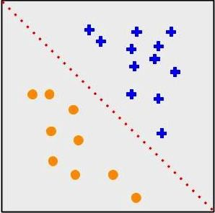
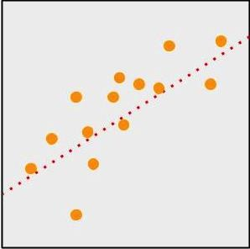
Types of Machine Learning Problems
Supervised
Classification
Output is a discrete variable(yes/no) (e.g., cat/dog), spam filtering
Unsupervised
Regression
Reinforcement
Output is continuous(numerical) (e.g., price, temperature), housing price

Slide 11
Types of Machine Learning Problems
Supervised
There is no desired output. Learn something about the data. Latent relationships.
The training data is unlabeled.
I have photos and want to put them in 20 group
I want to find anomalies in the credit card usage patterns of my customers.
Unsupervised
Reinforcement

Slide 12
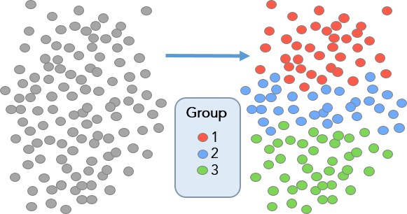
Types of Machine Learning Problems
Supervised
Useful for learning structure in the data (clustering), hidden correlations, reduce dimensionality, etc.
Unsupervised
Reinforcement

Slide 13
Types of Machine Learning Problems
Supervised
An agent interacts with an environment and watches the result of the interaction
Environment gives feedback via a positive or negative reward signal.
Unsupervised
Reinforcement

Slide 14
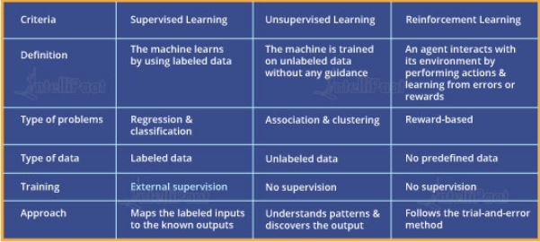
Difference

Slide 15
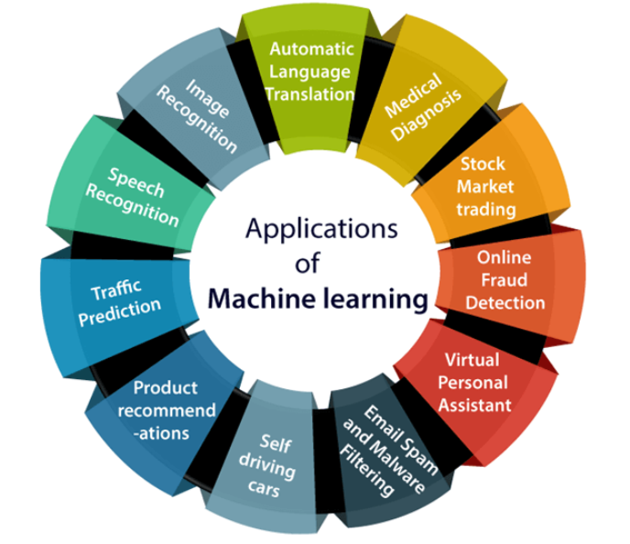
Applications of Machine Learning

Slide 16
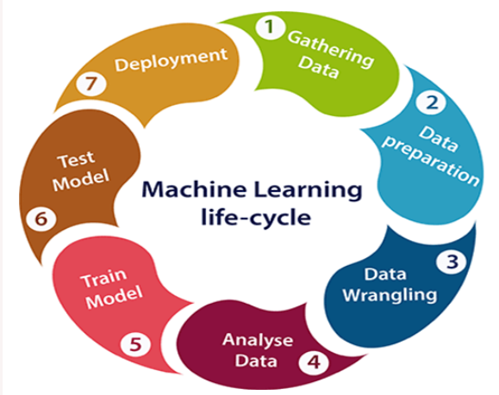
Machine learning life cycle

Slide 17
1. Gathering Data
To solve a problem, we create a machine learning system called "model", and this model is created by providing "training". But to train a model, we need data, hence, life cycle starts by collecting data.
The quantity and quality of the collected data will determine the efficiency of the output.
The more will be the data, the more accurate will be the prediction.
This step includes the below tasks:
Identify various data sources
Collect data
Integrate the data obtained from different sources

Slide 18
2. Data Preparation
The process of data preparation can be further divided into two processes:
Data exploration:
It is used to understand the nature of data that we have to work with. We need to understand the characteristics, format, and quality of data.
In this, we find Correlations, general trends, and outliers.
Data pre-processing:
Now the next step is preprocessing of data for its analysis.

Slide 19
3. Data Wrangling
It is the process of cleaning and converting raw data into a useable format.
It is the process of cleaning the data, selecting the variable to use, and transforming the data in a proper format to make it more suitable for analysis in the next step.
In real-world applications, collected data may have various issues, including:
Missing Values
Duplicate data
Invalid data
Noise
So, we use various filtering techniques to clean the data.

Slide 20
4. Data Analysis
Now the cleaned and prepared data is passed on to the analysis step. This step involves:
Selection of analytical techniques
Building models
Review the result
It starts with the determination of the type of the problems, where we select the machine learning techniques such as Classification, Regression, Cluster analysis, Association, etc. then build the model using prepared data, and evaluate the model.

Slide 21
5. Train Model
In this step we train our model to improve its performance for better outcome of the problem.
We use datasets to train the model using various machine learning algorithms.

Slide 22
6. Test Model
Once our machine learning model has been trained on a given dataset, then we test the model.
In this step, we check for the accuracy of our model by providing a test dataset to it.
Testing the model determines the accuracy percentage of the model as per the requirement of project or problem.

Slide 23
7. Deployment
The last step of machine learning life cycle is deployment, where we deploy the model in the real-world system.
If the above-prepared model is producing an accurate result as per our requirement with acceptable speed, then we deploy the model in the real system.
But before deploying the project, we will check whether it is improving its performance using available data or not.

Slide 24
Supervised Machine Learning
Supervised learning is the types of machine learning in which machines are trained using well "labelled" training data.
The labelled data means some input data is already tagged with the correct output.
On basis of that data, machines predict the output.
In supervised learning, the training data provided to the machines work as the supervisor that teaches the machines to predict the output correctly.
The aim of a supervised learning algorithm is to find a mapping function to map the input variable(x) with the output variable(y).
Example: Risk Assessment, Image classification, Fraud Detection, spam filtering, etc.

Slide 25
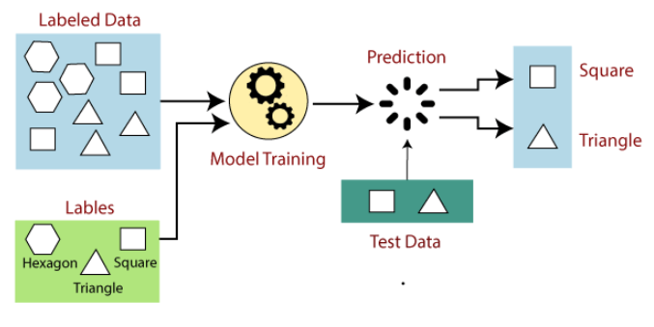
How Supervised Learning Work?
After the training process is completed, the model is tested on the basis of test data (a subset of the training set), and then it predicts the output.

Slide 26
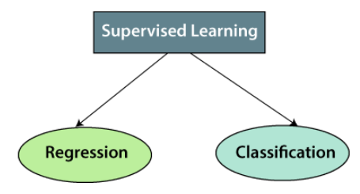
Types of supervised Machine learning Algorithms

Slide 27
Regression
It is used for the prediction of continuous variables, such as Weather forecasting, Market Trends, etc. Below are some popular Regression algorithms which come under supervised learning:
Linear Regression
Regression Trees
Non-Linear Regression
Bayesian Linear Regression
Polynomial Regression

Slide 28
Classification
Classification algorithms are used when the output variable is categorical, which means there are two classes such as Yes-No, Male-Female, True-false, etc.
Below mentioned are some of the types of Classification:
Random Forest
Decision Trees
Logistic Regression
Support vector Machines

Slide 29
Advantages of Supervised Learning
With the help of supervised learning, the model can predict the output on the basis of prior experiences.
Supervised learning is a simple process for you to understand. In the case of unsupervised learning, we don’t easily understand what is happening inside the machine, how it is learning, etc.
Supervised learning can be very helpful in classification problems
Supervised learning model helps us to solve various real-world problems such as fraud detection, spam filtering, etc.

Slide 30
Disadvantages of supervised learning:
Supervised learning models are not suitable for handling the complex tasks.
Supervised learning cannot give you unknown information from the training data like unsupervised learning do.
Supervised learning cannot predict the correct output if the test data is different from the training dataset.
Training requires lots of computation times.
While you are training the classifier, you need to select a lot of good examples from each class. Otherwise, the accuracy of your model will be very less.

Slide 31
Unsupervised Learning
Unsupervised learning is a type of machine learning in which models are trained using unlabeled dataset and are allowed to act on that data without any supervision.
Here models are not supervised using training dataset. Instead, models itself find the hidden patterns and insights from the given data.

Slide 32
Why Unsupervised Learning?
Unsupervised learning is helpful for finding useful insights from the data.
Unsupervised learning is much similar as a human learns to think by their own experiences, which makes it closer to the real AI.
Unsupervised learning works on unlabeled and uncategorized data which make unsupervised learning more important.
In real-world, we do not always have input data with the corresponding output so to solve such cases, we need unsupervised learning.

Slide 33
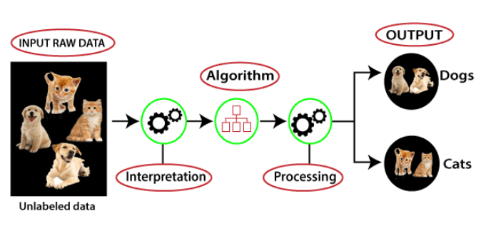
Working of Unsupervised Learning

Slide 34
Types of Unsupervised Learning Algorithm:
Clustering
Clustering is a method of grouping the objects into clusters such that objects with most similarities remains into a group
Association
It is used for finding the relationships between variables in the large database.
Cluster analysis finds the commonalities between the data objects and categorizes them as per the presence and absence of those commonalities.
Association rule makes marketing strategy more effective. Such as people who buy X item (suppose a bread) are also tend to purchase Y (Butter/Jam) item.

Slide 35
Advantages of Unsupervised Learning
Labeling of data demands a lot of manual work and expenses. Unsupervised learning solves the problem by learning the data and classifying it without any labels.
Unsupervised learning is preferable as it is easy to get unlabeled data in comparison to labeled data.
It is very helpful in finding patterns in data, which are not possible to find using normal methods.

Slide 36
Disadvantages of Unsupervised Learning
Unsupervised learning is intrinsically more difficult than supervised learning as it does not have corresponding output.
The result of the unsupervised learning algorithm might be less accurate as input data is not labeled, and algorithms do not know the exact output in advance.
The more the features, the more the complexity increases.
It is also a time-consuming process. The learning phase of the algorithm might take a lot of time, as it analyses and calculates all possibilities.

Slide 37
Reinforcement Learning
Reinforcement Learning is a feedback-based Machine learning technique.
RL solves a specific type of problem where decision making is sequential, and the goal is long-term, such as game-playing, robotics, etc.
The agent interacts with the environment and explores it by itself. The primary goal of an agent in reinforcement learning is to improve the performance by getting the maximum positive rewards.
The agent learns with the process of hit and trial, and based on the experience, it learns to perform the task in a better way.

Slide 38
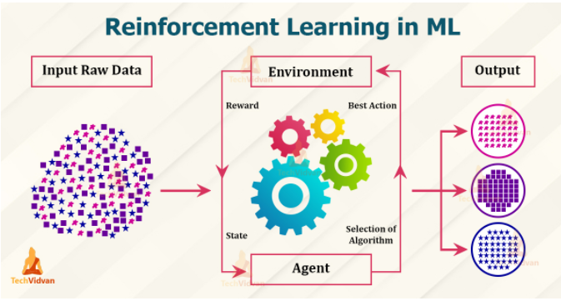
How Does it Work?

Slide 39
Key Features of Reinforcement Learning
In RL, the agent is not instructed about the environment and what actions need to be taken.
It is based on the hit and trial process.
The agent takes the next action and changes states according to the feedback of the previous action.
The agent may get a delayed reward.
The environment is stochastic, and the agent needs to explore it to reach to get the maximum positive rewards.

Slide 40
Types of Reinforcement Learning
Positive Reinforcement
Here, we try to add a reward for every good result in order to increase the likelihood of a good result.
Negative Reinforcement
It is opposite to the positive reinforcement as it increases the tendency that the specific behavior will occur again by avoiding the negative condition.
Too much positive reinforcement may lead to an overload of states that can reduce the consequences.
It can be more effective than the positive reinforcement depending on situation and behavior, but it provides reinforcement only to meet minimum behavior.

Slide 41
Advantages of Reinforcement Learning
It can solve higher-order and complex problems. Also, the solutions obtained will be very accurate.
This model will undergo a rigorous training process that can take time. This can help to correct any errors.
Since the model learns constantly, a mistake made earlier would be unlikely to occur in the future.

Slide 42
Disadvantages of Reinforcement Learning
The usage of reinforcement learning models for solving simpler problems won’t be correct. The reason being, the models generally tackle complex problems.
We need lots of data to feed the model for computation. Reinforcement Learning models require a lot of training data to develop accurate results.
This consumes time and lots of computational power.

Slide 43
Application of Reinforcement Learning
RL models of companies can analyze customer preferences and help in the better advertisement of the products.
We have Deep learning algorithms like AlphaGo, AlphaZero that are gaming algorithms for games like chess, shogi and go.
RL is now a big help in recommendation systems like news, music apps, and web-series apps like Netflix, etc. These apps work as per customer preferences.
Reinforcement learning helps to understand chemical reactions. We can try to have cleaner reactions that yield better products.

Slide 44
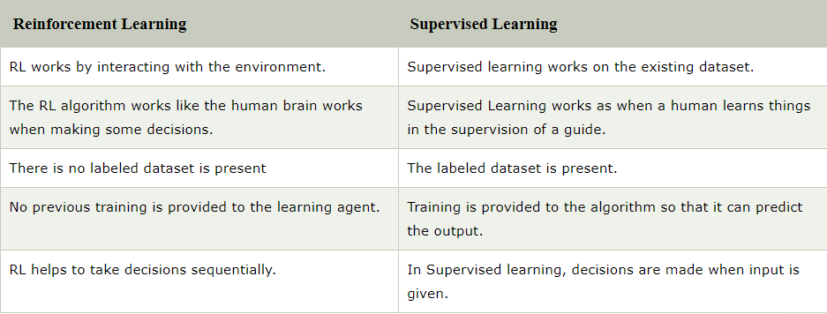
Reinforcement Learning Vs Supervised Learning

